Slide 1
WHAT IS METAVERSE
Syed Muhammad Imran

Slide 2

A BRIEF HISTORY OF THE FUTURE
The term Metaverse was coined in 1992 by science fiction writer Neal Stephenson in novel Stone Crash. Its most basic definition refer to.
The concepet of a fully immersive virtual world where people gather to socialize, play, and work
Roughly 15 million human controlled avatars.
In Snow Crash the Metaverse has made life in the real world worse

Slide 3

THE PROGRAME IS MORE OPTIMISTIC THEN THE PEN
Yet there is no reason to assume that such an outcome is inevitable, or even likely, for the actual Metaverse

Slide 4

The Coming Fight to Control the Metaverse (and You)
This Metaverse is going to be far more pervasive and powerful than anything else. If one central company gains control of this, they will become more powerful than any government and be a god of Earth.
The “openness” of the internet enabled more companies to be build, in more areas, reaching more users, and achieving greater profits, while also preventing pre-internet giants (and, crucially, telecom companies) from controlling it.

Slide 5
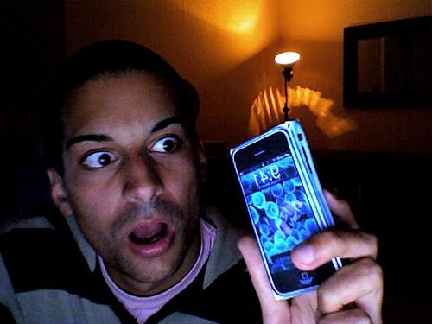
CONFUSION AND UNCERTAINITY
The term has no consensus definition or consistent description, “entire world into an app canvas” which could be augmented by cloud software and machine learning.
Mark zuckerberg’s articulation focused on immersive virtual reality as well social experiences that connect individuals who live far apart.
“An expansive, digitilized communal space where users can mingle freely with brands and one another in ways that permit self-expression and spark joy.

Slide 6
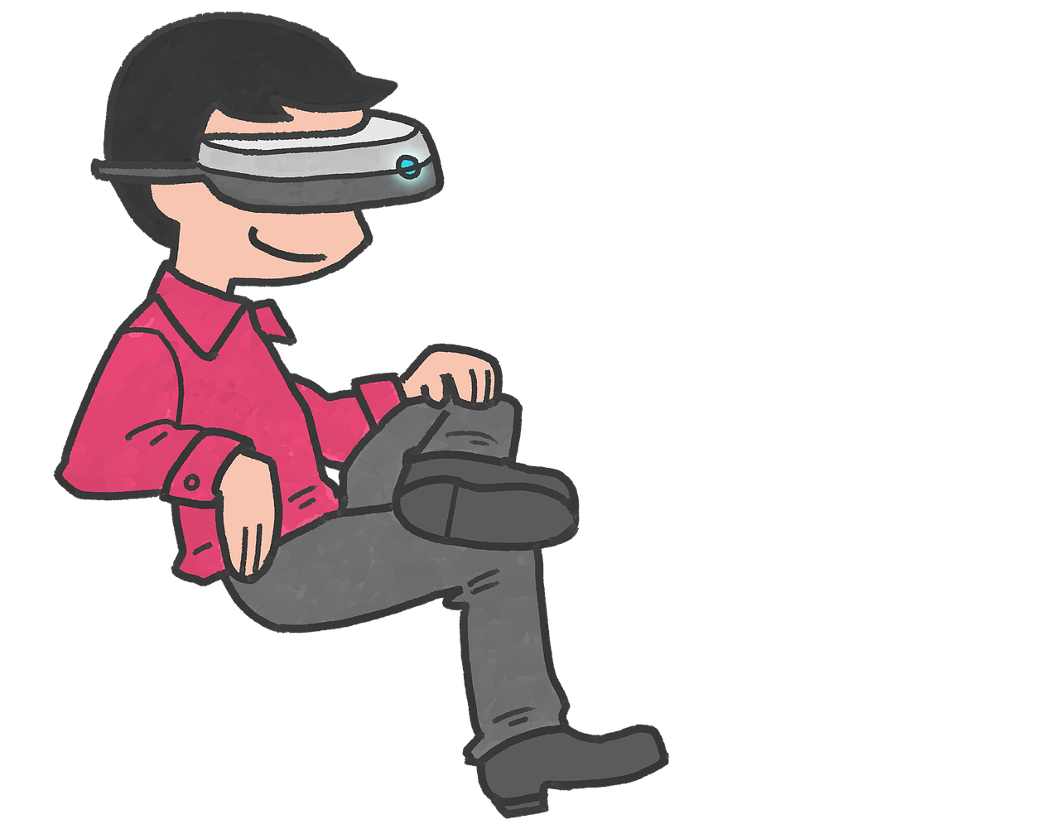
VIRTUAL WORLD
Virtual world refer to any computer generated simulated environment. These environment can be in immersive 3D, 3D, 2.5D (also known as isometric 3D)
These world can have no individual user, these users might affect and be affected by this virtual world through any number of devices, such as a keyboard, motion sensor, or even a camera that tracks their motion.
In recent year, the biggest upstick in virtual world creation has been via worlds which have no “gameplay” whatsoever. A digital twin of the Hong Kong international Airport.

Slide 7
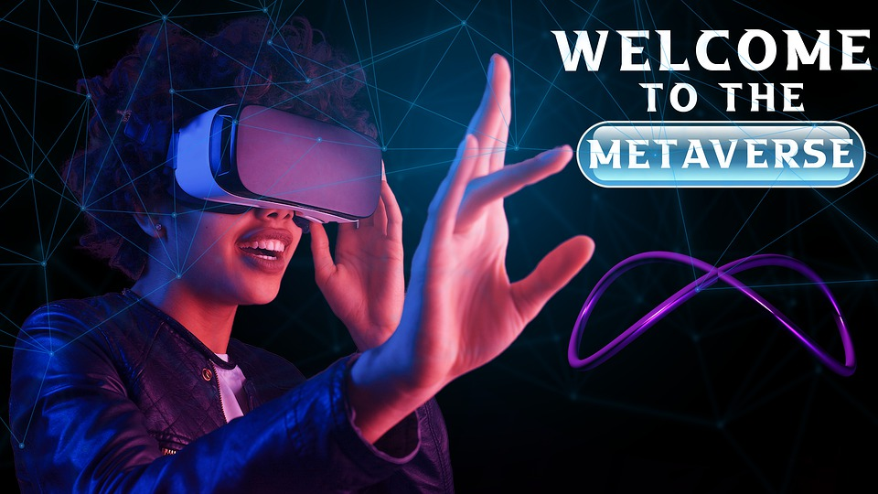
A DEFINATION
“A massively scaled and interperable network of realtime rendered 3D virtual world that can be experienced synchronously, and persistently, by an effectively unlimited number of data, such as identity, history, entitlements, objects, communications, and payments.”
(FINALLY)

Slide 8
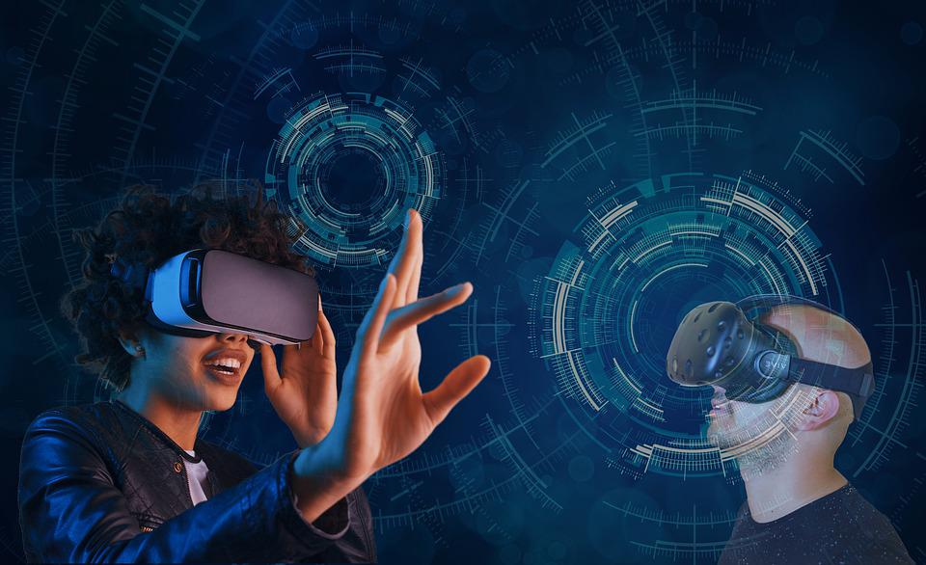
3D
Although virtual worlds come in many dimensions, 3D is a critical specification for the Metaverse. Without 3D, we might as well be describing the current internet. Certainly, humans did not evolve for thousand years to use a flat touchscreen.
It is important to emphasize,that while the Metaverse should be understood as a 3D experience, this does not mean that everything inside the Metaverse will be in 3D

Slide 9

REAL TIME RENDERED
Virtual world requires real-time rendering.
Although real-time rendering enables a virtual world to be “alive” and respond to input from a user (or a group of users, for that matter) it means that a minimum of 30 and ideally 120 frames, must be rendered each second.

Slide 10
THE NEXT INTERNET

Slide 11

THE NEXT INTERNET
My Definition of The Metaverse Should Provide some insight into why it is often thought of, and fairly described as a successor to the mobile internet.
As shrewd business leaders know well, every time a new computing and networking platform emerges, the world and the companies that lead it are forever changed.
indeed , generational changes in computing and networking platforms routinely disrupt even the most stagnant and protected categories. blockchain /Cryptocurrency networks, which to many experts are foundational enablers of the Metaverse. Metaverse as the “next-generation of internet”

Slide 12


Slide 13


BLOCKCHAIN
CRYPTOCURRENCY

Slide 14

Is blockchain necessary for metaverse?
“You don't need blockchain to enable the metaverse,” Yonatan Raz-Fridman, founder, and CEO, SuperSocial, said. Blockchain will play a key role in the Metaverse along with artificial intelligence (AI) and virtual reality (VR).

